Slide 1
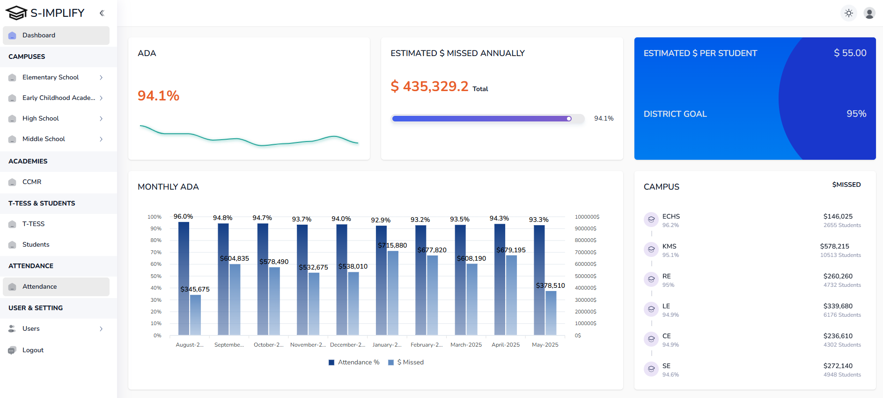
Add months in the X axis
Remove the bar graphs and move all campuses to this section for more clarity

Slide 2
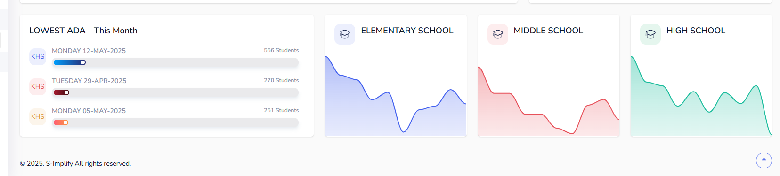
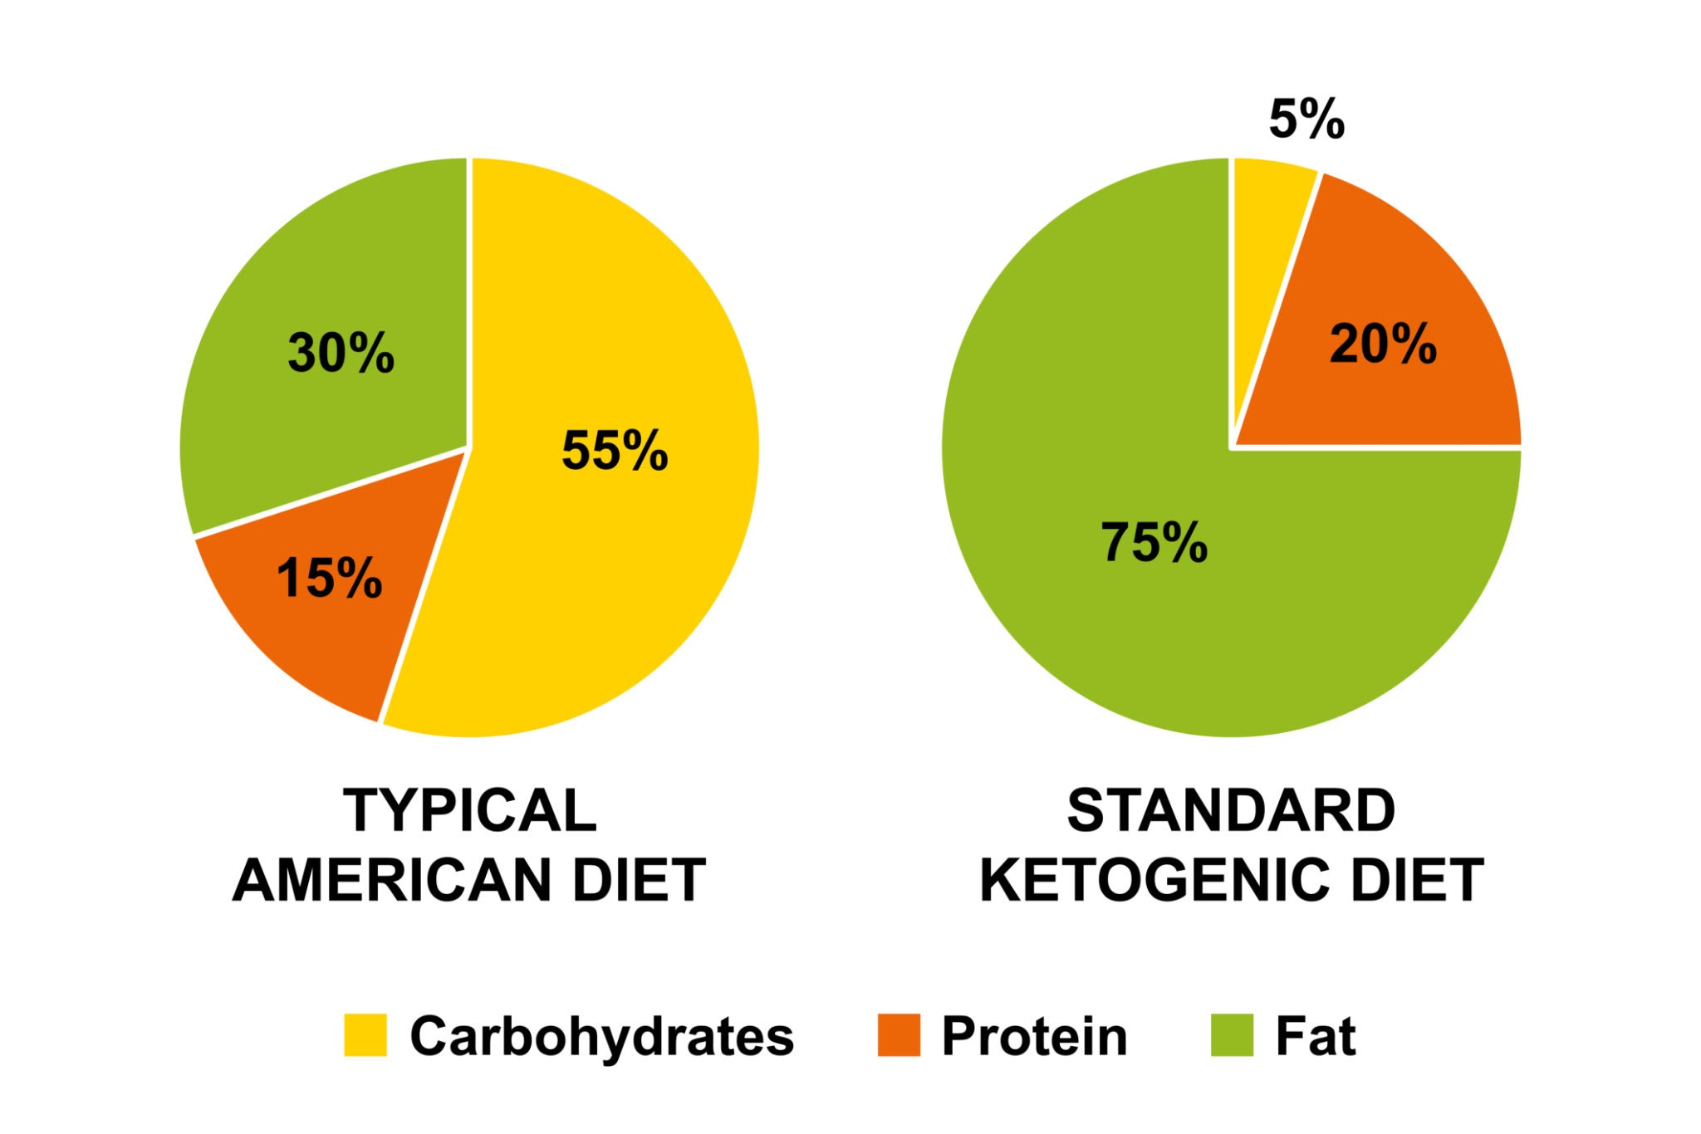
Remove all the tiles below and add ind. student ADA reports
Clicking on any section of the pie chart will take the user to the list of students that have that specific ADA,
KHS NMS ME CE

